Slide 1
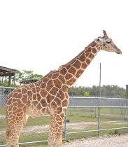
Giraffes: Fun Facts
Yellow & Brown
Africa
Towers
Herbivores
Leafy Meals
Long Tongues

